Slide 1
Test Models vs Test Cases
Transmitter Test Case | FR1-TM1.1 | FR1-TM1.2 | FR1-TM2 | FR1-TM2a | FR1-TM3.1 | FR1-TM3.1a | FR1-TM3.2 | FR1-TM3.3
BS output power | Yes
Output power dynamics |  |  | Yes *1 | Yes *1 | Yes *2 | Yes *2
Transmit ON/OFF power | Yes
Transmitted signal quality |  |  | Yes | Yes | Yes | Yes | Yes | Yes
Unwanted emissions | Yes | Yes
ACLR
Operating band unwanted emissions |  | Yes
Transmitter spurious emissions
Transmitter intermodulation | Yes
Lower OFDM symbol power limit at min power
Upper OFDM symbol power limit at max power with all 64QAM PRBs allocated

Slide 2
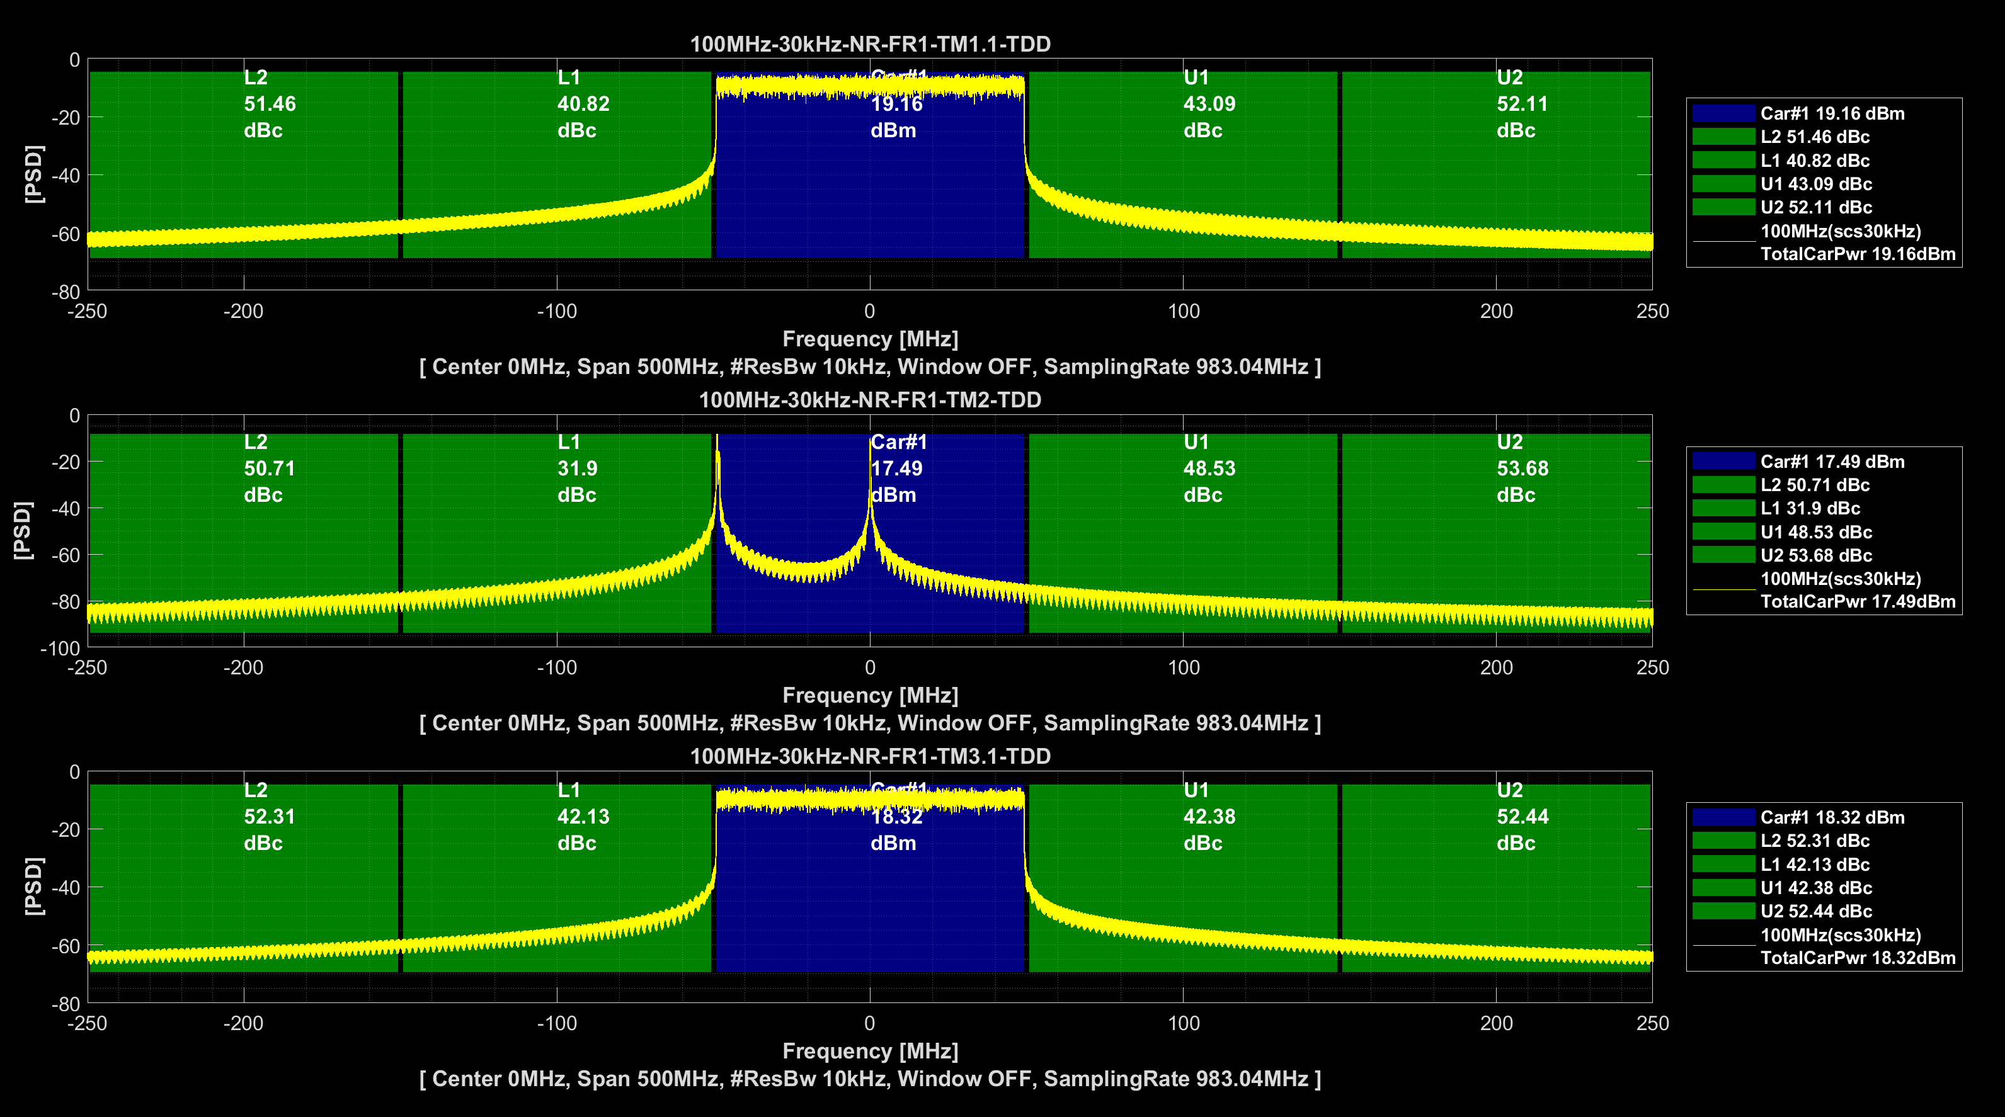
Spectrum: TM1.1/TM2/TM3.1

Slide 3
Waveform and PAR: TM1.1/TM2/TM3.1

Slide 4
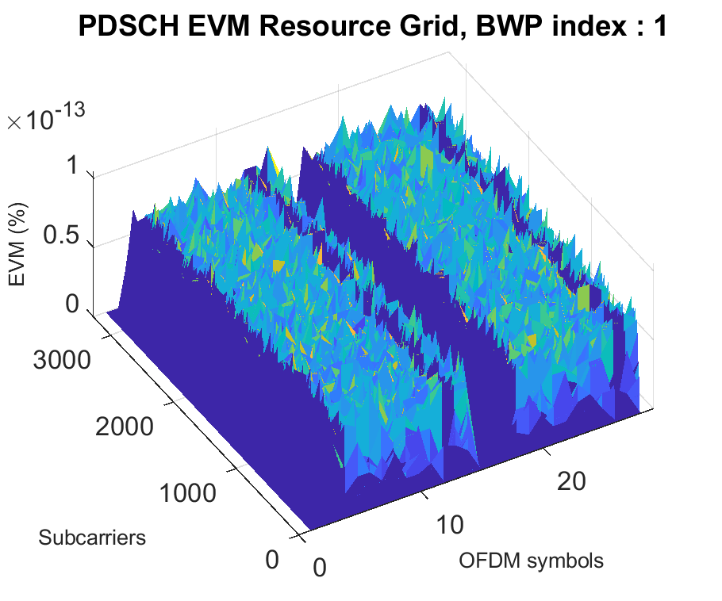
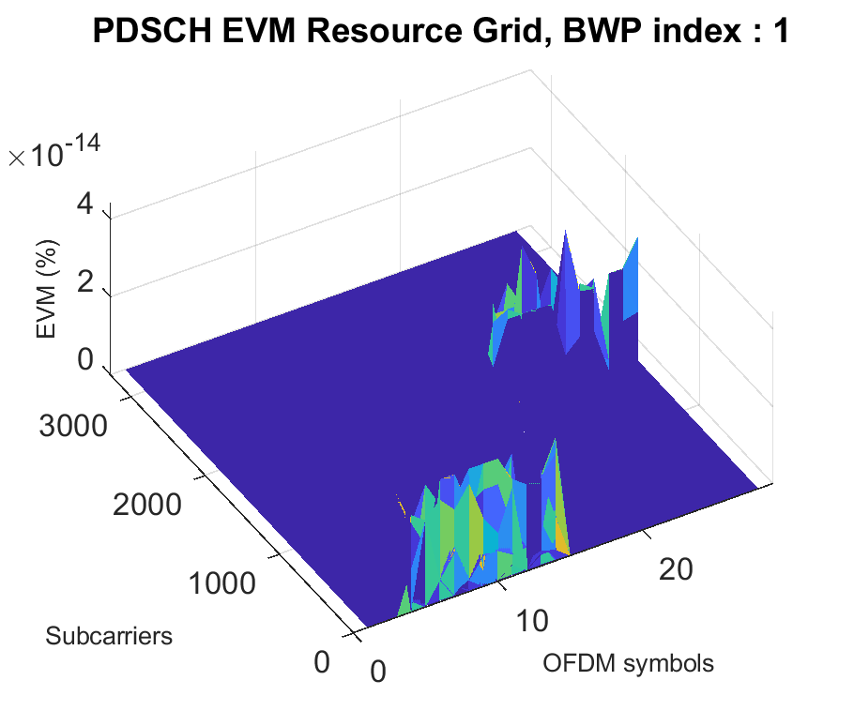
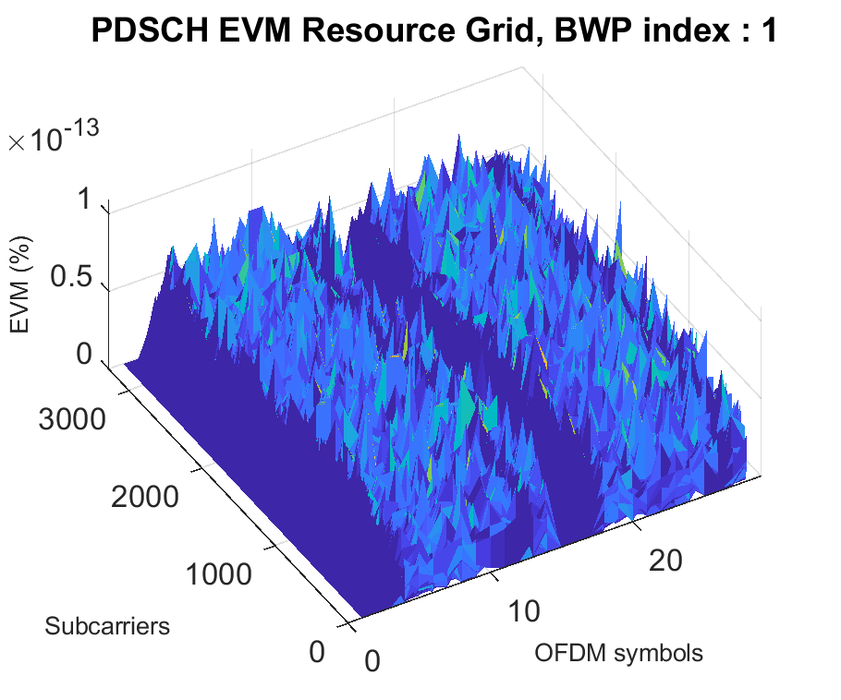
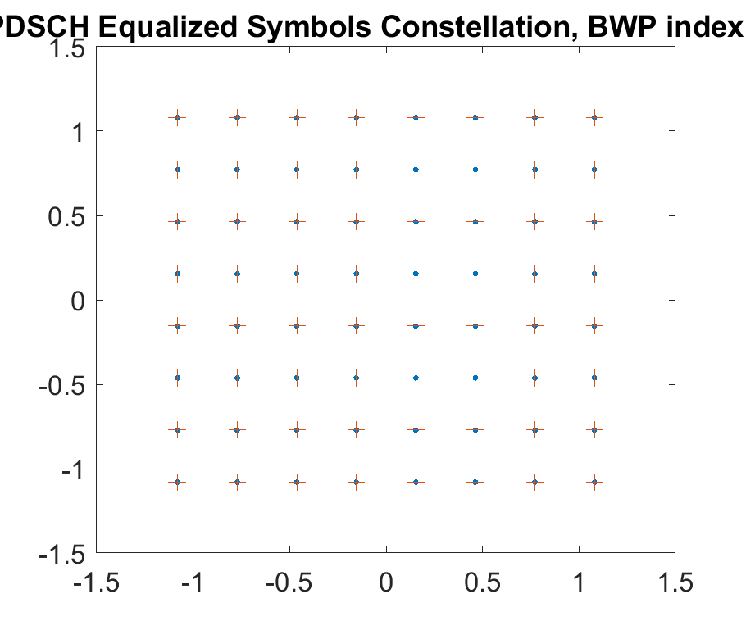
PDSCH Demodulation: TM1.1/TM2/TM3.1
TM1.1
TM2
TM3.1

Slide 5
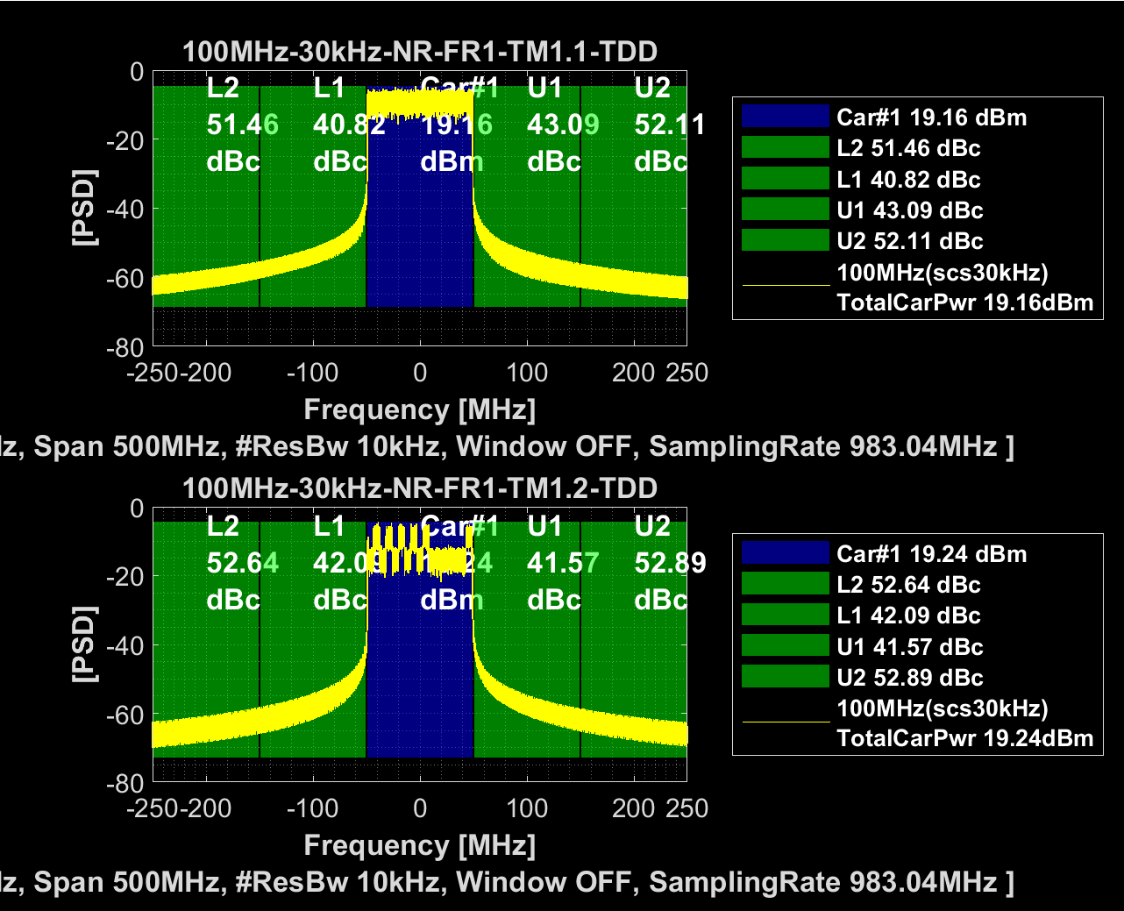
Spectrum: TM1.1/TM1.2

Slide 6
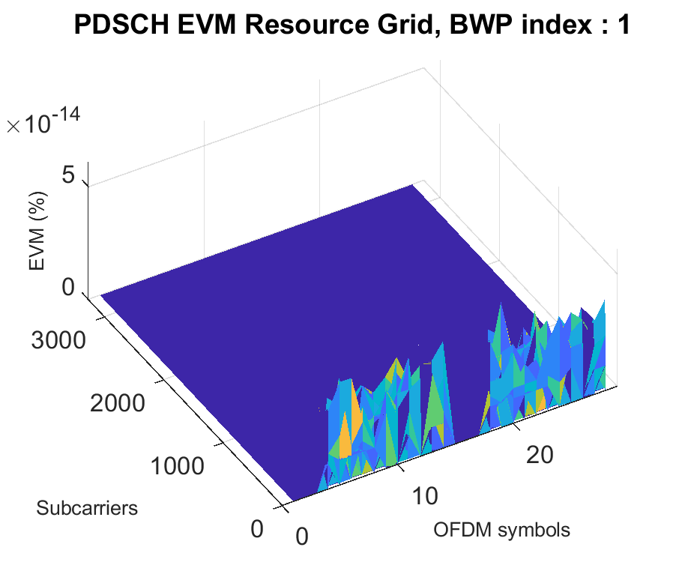
PDSCH Demodulation: TM1.1/TM1.2
TM1.1
TM1.2

